Slide 1

Machine Learning Using Python
-

Slide 2
What is Machine Learning?
A subset of artificial intelligence (AI) that focuses on developing algorithms and models that enable computers to learn from data and make predictions or decisions without being explicitly programmed.

Slide 3











Machine Learning Types
Machine Learning
Supervised Learning
Unsupervised Learning
Semi-Supervised Learning
Reinforcement Learning
Self-Supervised Learning
Meta-Learning
Classification
Clustering
Regression
Dimensionality Reduction

Slide 4

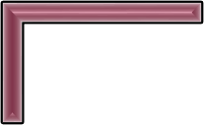

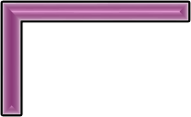





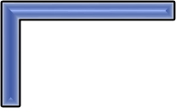

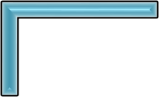

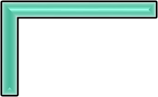

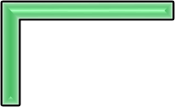

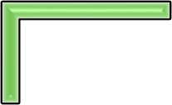

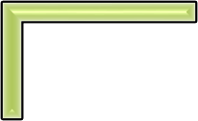

Supervised Learning Process
Deploy the Model
Iterate and Improve
Evaluate on the test set
Validate and Tune Hyperparam eters
Train the
Model
Split Data for Training and Testing
Select a Model
Feature Engineering
Data Preprocessin g
Collect and Prepare Data
Define the Problem

Slide 5
Feature Engineering
A feature is an attribute of a data set that is used in a machine learning process.
Feature engineering refers to the process of translating a data set into features such that these features are able to represent the data set more effectively and result in a better learning performance.
It has two major elements:
Feature Transformation
Feature Subset Selection

Slide 6
Feature Transformation
Transforms the data into a new set of features which can represent the underlying problem which machine learning is trying to solve.

Slide 7
Feature Subset Selection
The objective of feature selection is to derive a subset of features from the full feature set which is most meaningful in the context of a specific machine learning problem.

Slide 8
Polynomial Regression
It iss the extension of the simple linear model by adding extra predictors obtained by raising (squaring) each of the original predictors to a power.
For example, if there are three variables, X, X² , and X³ are used as predictors. This approach provides a simple way to yield a non-linear fit to data.

Slide 9
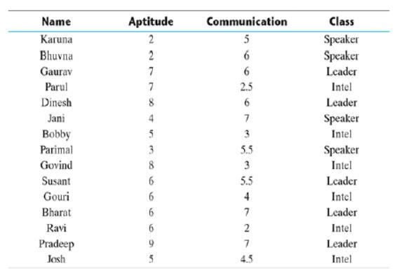
kNN –k Nearest Neighbours

Slide 10
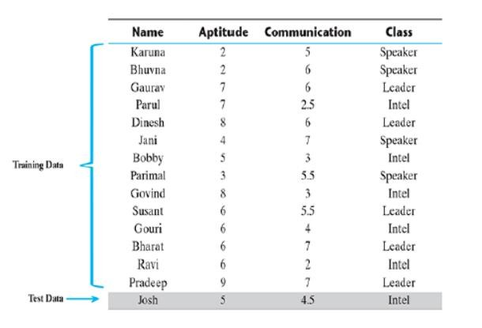
kNN –k Nearest Neighbours

Slide 11
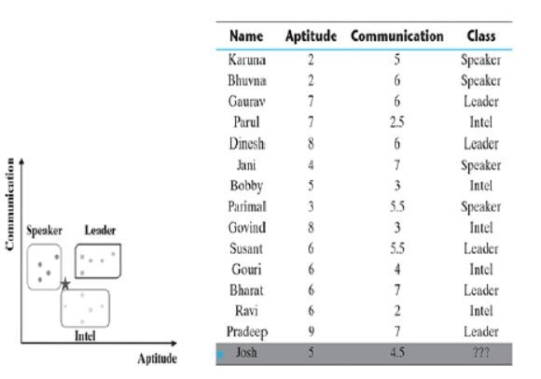
kNN –k Nearest Neighbours

Slide 12
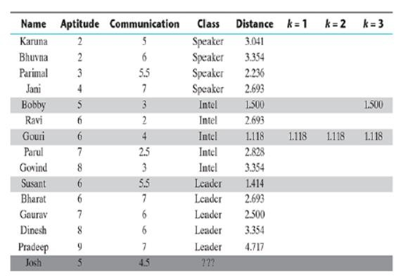
kNN –k Nearest Neighbours

Slide 13
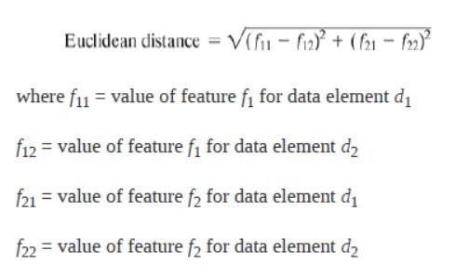
kNN –k Nearest Neighbours

Slide 14
Confusion Matrix
There are four possibilities with regards to the cricket match win/loss prediction:
1. the model predicted win and the team won (TP)
2. the model predicted win and the team lost (FP)
3. the model predicted loss and the team won (FN)
4. the model predicted loss and the team lost (TN)

Slide 15
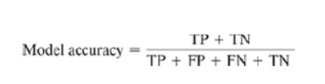
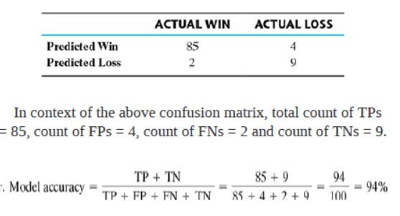
Model Accuracy

Slide 16
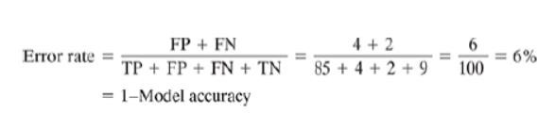
Error Rate

Slide 17

Sensitivity
The sensitivity of a model measures the proportion of TP examples or positive cases which were correctly classified.

Slide 18

Specificity
Specificity of a model measures the proportion of negative examples which have been correctly classified.

Slide 19
Decision Trees
Decision tree learning is one of the most widely adopted algorithms for classification.
As the name indicates, it builds a model in the form of a tree structure.

Slide 20
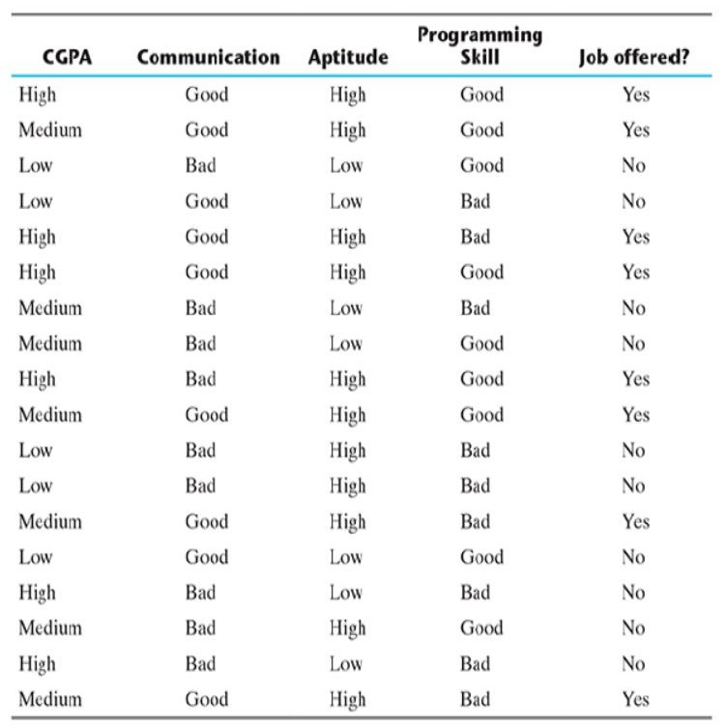
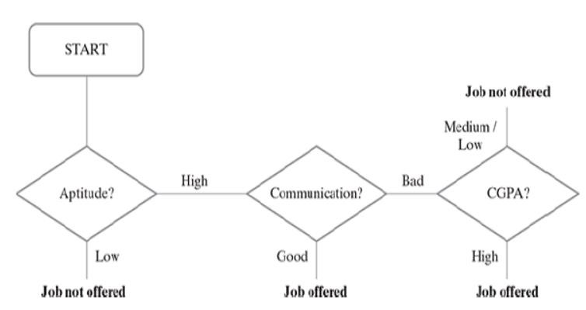

Slide 21
Decision Tree Implementation
There are many implementations of decision tree, the most prominent ones being C5.0, CART (Classification and Regression Tree), CHAID (Chi-square Automatic Interaction Detector) and ID3 (Iterative Dichotomiser 3) algorithms.
The biggest challenge of a decision tree algorithm is to find out which feature to
split upon.
The main driver for identifying the feature is that the data should be split in such a way that the partitions created by the split should contain examples belonging to a single class. If that happens, the partitions are considered to be pure.

Slide 22

Entropy
Entropy is a measure of impurity of an attribute or feature adopted by many algorithms such as ID3 and C5.0.
Let us say S is the sample set of training examples. Then, Entropy (S) measuring the
impurity of S is defined as
where c is the number of different class labels and p refers to the proportion of
values falling into the i-th class label.

Slide 23

Information Gain
The information gain is calculated on the basis of the decrease in entropy (S) after a data set is split according to a particular attribute (A).
Constructing a decision tree is all about finding an attribute that returns the
highest information gain (i.e. the most homogeneous branches).
Information gain for a particular feature A is calculated by the difference in entropy before a split (or S_{bs} ) with the entropy after the split (S_{as} ).

Slide 24
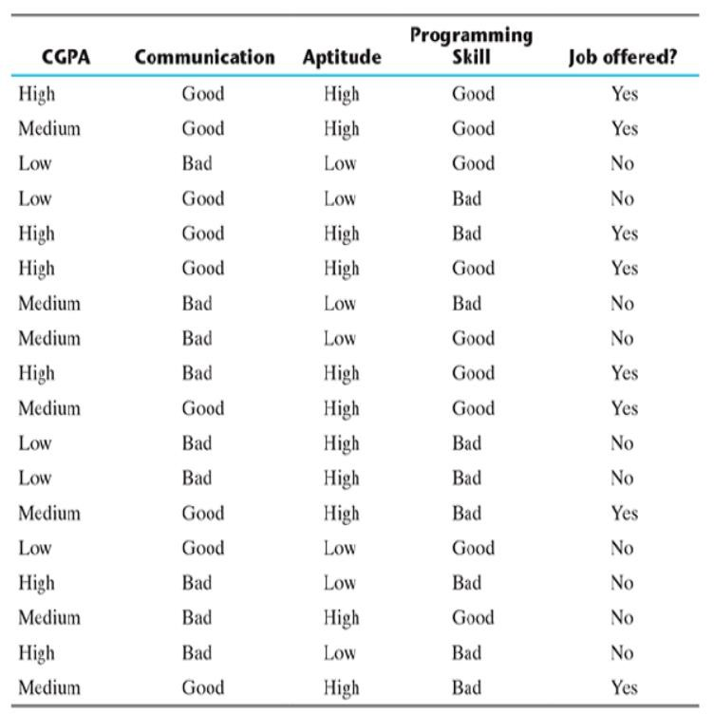

Slide 25
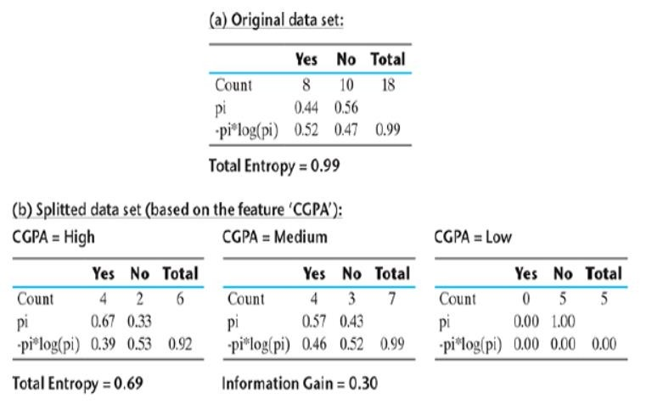

Slide 26
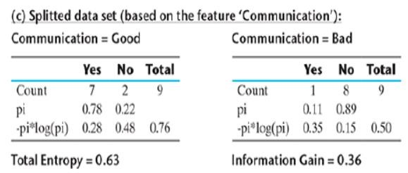

Slide 27
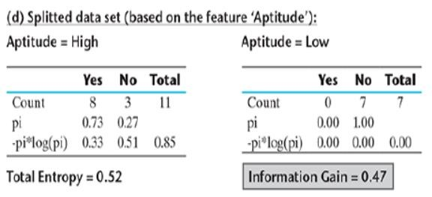

Slide 28
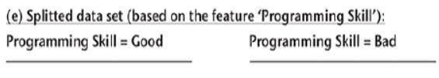
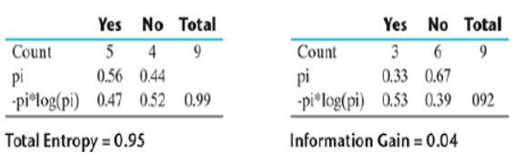

Slide 29
Aptitude
Hence, it is quite evident that among all the features, Aptitude results in the best information gain when adopted for the split.
So, at the first level, a split will be applied according to the value of Aptitude or in
other words, Aptitude will be the first node of the decision tree formed.
One important point to be noted here is that for Aptitude = Low, entropy is 0, which indicates that always the result will be the same irrespective of the values of the other features.
Hence, the branch towards Aptitude = Low will not continue any further.

Slide 30
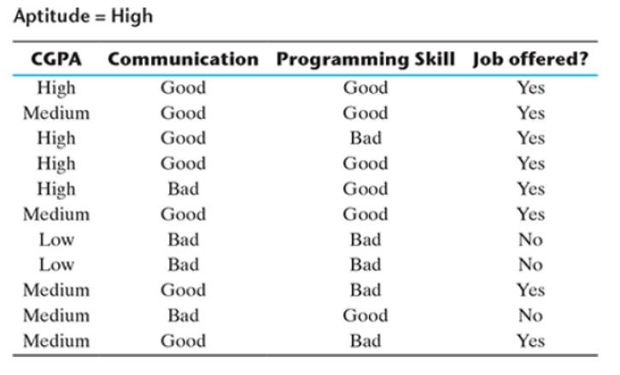

Slide 31
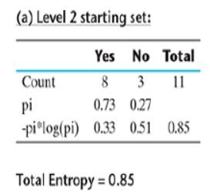

Slide 32

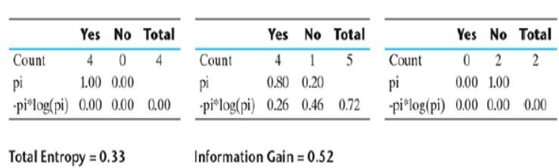

Slide 33
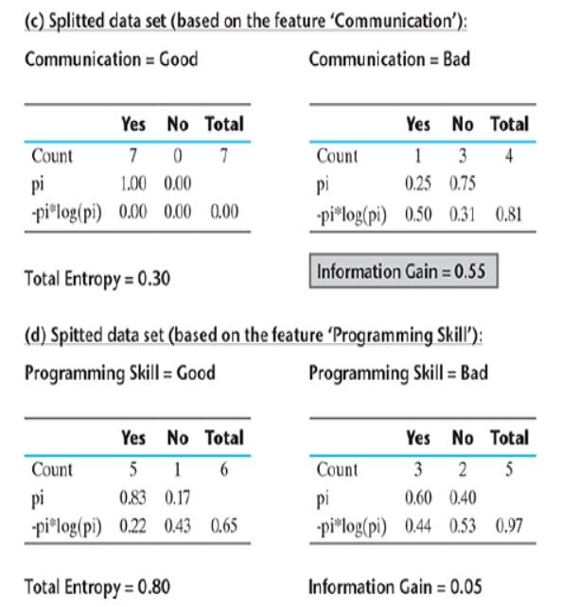

Slide 34

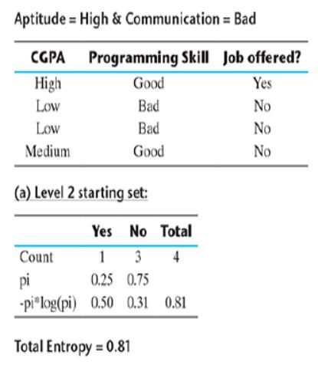
3
3

Slide 35
